Slide 1
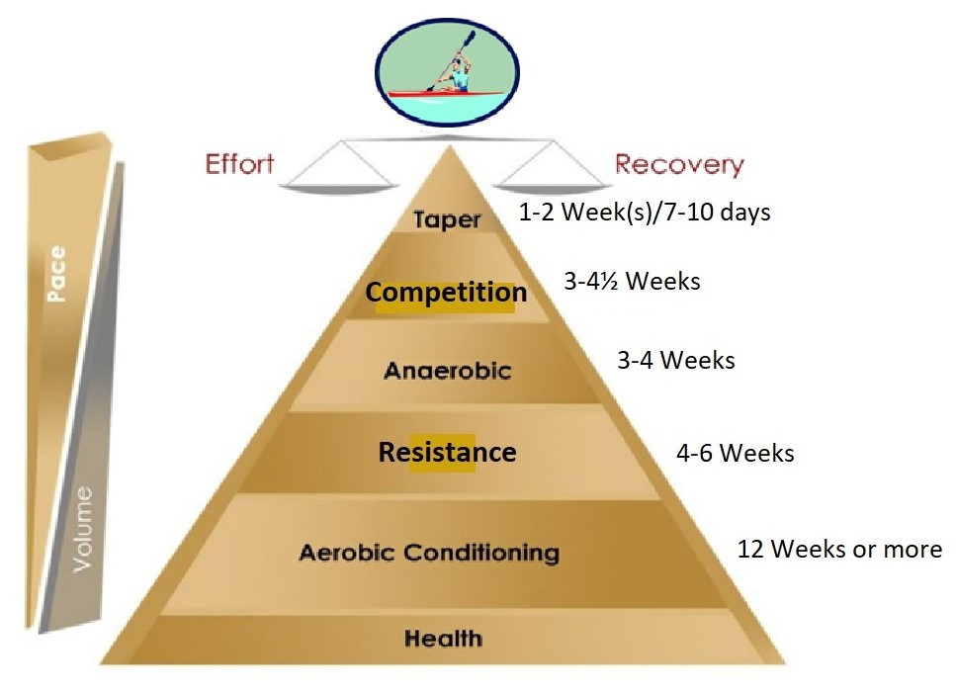
My Training Philosophy

Slide 2
Designing an effective training plan means pitching the paces and sessions durations for where you are at. The pyramid is easily adapted to the number of days, and the amount of time, one wishes to spend training.
Maximize Your Aerobic Capacity
First and foremost, teach your body to utilize oxygen and produce energy at its optimal level. This is called Building Your Base. Slow and easy does it!
Sequential Development of Energy Systems
Endurance, strength, anaerobic development, race pace and speed are developed in sequence. Each phase of training builds upon the one before. When the endurance base is insufficiently developed, your pace will ultimately suffer.
Response−Regulated Recovery
Recovery is the equal partner of activity. It is during the recuperative phase, not the activity, that your body makes its adaptations and gets fitter. -Elite athletes recover faster during light activity, than under passive rest.

Slide 3
Correct Timing
There is an optimal time for each work-out. What might seem to be a perfect workout, but done at the wrong time, can have a completely opposite effect of what you are seeking.
The core of training is the quantity and quality of the base training.
Long, moderate-pace training is anabolic whereas high-intensity demanding training, while having its place, is catabolic.
The base is critical to prevent overtraining.
“Marathon” or Long-Distance Training for a 500m paddler is difficult for many coaches and particularly athletes to understand. Many have been quite dismissive about the benefits in the face of the outstanding results associated with “marathon training”. To them it makes no sense training slowly for a speed event! -The rule of specificity is violated.

Slide 4
Why then does it work?
Today our knowledge of physiology provides some answers:
Long endurance training appears to provide protection against overtraining from too much high-intensity speed work. Therefore, more race-related training may be accomplished due to better overall balance in the program (20-25% Anaerobic vs. 75-80% Aerobic). The harder you train, the more aerobic recovery work (i.e., very low intensity) is needed. This stimulates the gentle flow of blood toxins to the liver, eliminating the acidosis and restoring the body to “neutral”. This is also why active recovery training is better than total rest. Failure to remove any mounting and prolonged acidosis will damage your body’s enzymes, muscles and red blood cells. It can also depress your nervous system, including your coordination.
Activation of fast-twitch muscle fibers is normally accomplished by high-intensity interval training, speed training or lifting of maximum weights in the gym. We now know that long moderate-pace training also activates fast-twitch muscle fibers, after slow-twitch fibers have become glycogen depleted after the first one to two hours (or previous days of training).

Slide 5
The “no pain, no gain” mentality has derailed more athletes than anything else.
First and foremost, it is important to learn to paddle the distance continuously and comfortably without strain. Many physiological changes are happening after just your first training. The cardiovascular system develops much more quickly than your muscular system. While you may feel you are capable of paddling faster, the muscles, and particularly the joints and ligaments (which have lesser blood supply), need time to strengthen. The program develops your entire body at a rate that minimizes the risk of injury and sets you up to progress to faster paces for many years of enjoyable training and racing. The secret to endurance is to go slowly at the beginning. -Even if you feel that you can go faster, don’t!
The younger the athletes, the less anaerobic training should be used in the schedule; and the ratio of anaerobic to aerobic training only increases as the athletes get older and fitter. Anaerobic workouts, done 2-3 times weekly, is more than sufficient.
On the other hand, alactic exercise (speed drills and short sprints with very long recoveries) is safe to perform frequently as it uses the creatine phosphate substrate, not glycogen.

Slide 6
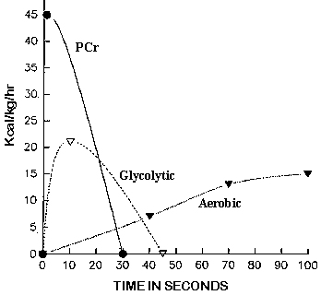
400m and 800m Running:
The aerobic/anaerobic energy system contribution to the 400m-running event was calculated as 41/59% (male) and 45/55% (female).
For the 800m-running event, an increased aerobic involvement was noted with a 60/40% (male) and 70/30% (female) respective contribution.
Energy system contribution to 400-metre and 800-metre track running - PubMed (nih.gov)

Slide 7
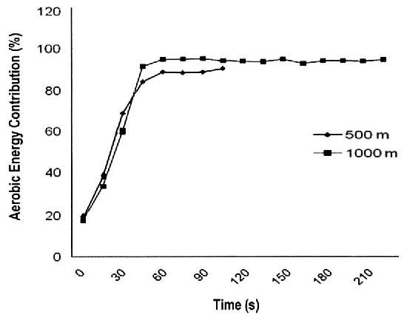
500m and 1000m Kayaking:
Olympic Flatwater Kayak paddlers spend most of their race distance at or around peak VO₂ and obtain the majority of the required energy from the aerobic system.
The aerobic contribution during the 1,000m is higher compared with that in the 500m. In brief, the aerobic contribution, expressed as a fraction of VO₂ max, has shown to be 73% for the 500m and 85% for the 1000m (lasting approximately 1min 45 and 3min 45 respectively).
The Metabolic Demands of Kayaking: A Review (nih.gov)

Slide 8
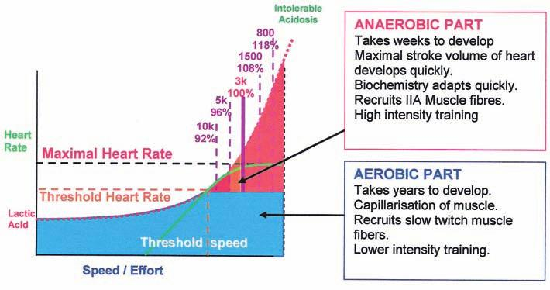
Your aerobic energy systems (blue) involving your slow-twitch fibres and cardiovascular system should have been developed to its maximum potential within the given timeframe of the Base Period (12-weeks or more).
The work capacity of your fast-twitch fibers (both Types IIA and IIB) should be increased via resistance work, strength training and fartlek workouts.
You should also aim to develop fine speed via technique- and speed-drills and short (10-second) sprints throughout the year.

Slide 9
Given that the layers of the training pyramid have been built to the level of the anaerobic threshold, now it’s time to lay down the (red) icing on the cake: to increase the capacity and power of your anaerobic energy system. A well-trained athlete only requires 4-5 weeks to develop this system to its physiological maximum.
Remember, anaerobic capacity is notoriously limited regardless of whether you’re an elite athlete or a “lazy person”. It doesn’t matter how much you train, the highest oxygen debt you can attain (in terms of its absolute amount) is around 15-18L. Depending on the distance, you can choose to exhaust this within a few minutes in a 500-1000m race or spread it over more hours, like you do during a marathon.

Slide 10
My Thoughts on:
Training 7 days a week – Year round
If you take one day off each week, year-round, it adds up to 50 days (1½ month!), where your competition can train more than you. And there will always be more days off than this during the training year (Travel, School-work, Busy at work, Family-events and perhaps Illness etc.). That´s why I think you shouldn´t plan a weekly day off if you are an elite athlete. Instead plan for days off, when you really need them, so they don´t become a habit. Sundays off becomes a habit that can influence your daily rhythm when the Competition Season starts with races on weekends (Where you need to perform your best on Saturdays and Sundays). -In this case I think taking Friday or Monday off is way better, if you need a mental break before or after competitions? If you need breaks think more on taking ½days off or employing more fun activities that provides a mental break, but also gives a technical-, tactical- and/or aerobic-stimulus.

Slide 11
Young Paddlers should in my opinion start out with days off:
U16 should paddle 5 days a week.
U18 should be paddling 6 days a week.
U21-23 should be paddling 6½-7 days a week (2 x ½ day of each week or 1 day of every 14 days).
Training volume should progressively increase from year to year, in sync with your improved recovery capabilities. Incorporating fewer rest days each week, is one way to make room for more (easy) training in the schedule.

Slide 12
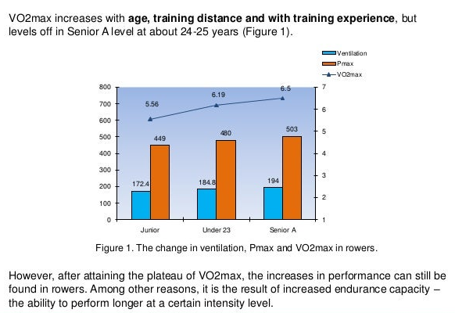

Slide 13
Continuous Paddling vs Interval Training
In the base period I think it is crucial to keep a constant pressure on the heart and lungs for long periods, to get the best aerobic adaptions. Interval training tends to start out faster than the athletes are capable of paddling aerobically. Instead, every interval starts out anaerobically with lactate being produced after every rest period, and this reduces the effectiveness of the aerobic system. The body gets accustomed to primarily using carbohydrates as fuel, whereas the aim should be to go faster, with the highest possible amount of energy supply coming from the aerobic systems fat utilization.
Most people are preoccupied with the concept of quality training. But how do you train with more quality tomorrow than you already did today? -Quality training requires more recovery time because of the higher intensity in training.

Slide 14
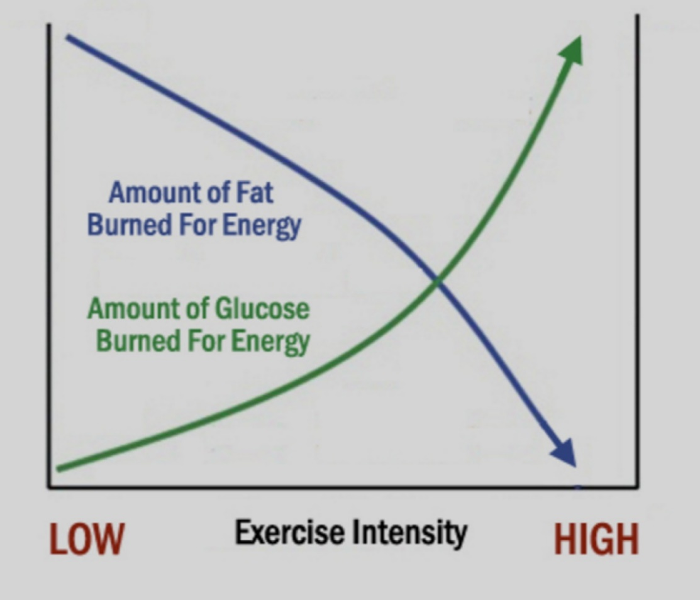

Slide 15
Low Intensity/High Volume to High Intensity/Low Volume and from General- to Specific Training during the year
Both the training year and the athletic career should be structured this way. The development going from large volume training with low intensity moving towards higher intensity and lower volume. Just as work is also done mowing from general to specific training stimulus and adaptions. A beginner can almost do any sport and still improve in a sport they are not even performing. Whereas an elite athlete will need to focus a very large amount of his/her training time towards improving just a few tenth of a second in their specific competition distance.

Slide 17
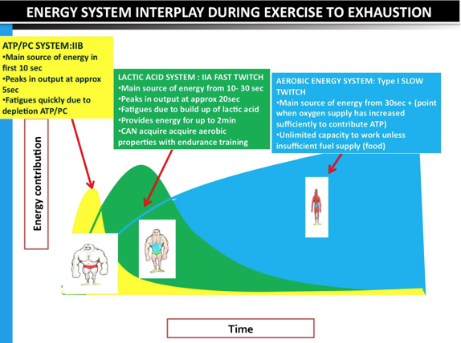

Slide 18
All three energy systems are contributing to providing energy throughout the event.
The first energy system to respond to meet the extra demand of ATP, once the race starts, is the ATP-PC system which is dominant for around 5-10 seconds. It continues to provide ATP after this point, but it is largely depleted after the 15 second mark.
At the 6 second mark the Anaerobic Glycolysis System becomes the dominant system and remains dominant until the 30 second mark.
At the 30 second mark the Aerobic mark continues to provide energy until the end of the race. At the 30 second mark however, the Aerobic System takes over and becomes the dominant supplier of ATP.

Slide 19
Questions?

Slide 20
Age category: | U14 | U16 | U18
Priority | “joyful and playful activities” | “Training to be able to train” | “Training to compete and perform”
Main Focus | Developing “Athletes”. Fundamental motor development, versatile movement experience and create good sporting habits. Introduction to Competition, rules and ethics. Swimming and water habituation (safety). | Specialization in kayaking. Optimizing paddle-specific technique. Participation in the development of rules for training and social rules of the sport. Control of intensity in training and introduction to training periodization. | Optimize paddle skills and technique. Team collaboration in crew boats. Gain greater international competition experience. Knowledge of exercise psychology, physiology and exercise planning.
Training Focus | (Games/play): Technique and balance. Explosiveness (general to specific), intro to aerobic training, technical training in crew boats. | (Challenging and inspiring training environment) Focus on Team collaboration, race tactics and technical optimization. Aerobic, strength, speed and intro to anaerobic training. | (Optimizing training environment) Detail-oriented individual technique training. Discipline specific; fitness, endurance, strength, speed and power.
Training volume | 5-6 Training sessions each week. (2-3 x Paddling + 2-3 x Other physical activities). 8-14 hours in total. | 6-11 Training sessions each week. (4-7 x Paddling + 2-4 x Other physical activities). 12-16 hours in total. | 10-12 Training sessions each week. (6-10 x Paddling + 2-6 x Other physical activities). 15-18 hours in total.
Psychological focus | “Making own experiences and not so much listening” Concrete actions and not so much abstract explanations. Experiment and imitate. | Personality development, identity and determination. Paddling/performing under difficult conditions. Dealing with psychological reactions to pressure. | Optimize race tactics and gain experience in dealing with the pressure (both individually and as a team). Winning mentality and focus.
Strength | Endurance core training. Circuit training, exercises with own body weight, technical Olympic and basic weightlifting exercises. Training zone: 5 - (>15) repetitions. | Overall strength and endurance. Circuit training and injury prevention. Training zone: 3 - (>20) repetitions. | Maximum strength, hypertrophy and explosive power. Circuit training and injury prevention. Training zone: 1 - (>25) repetitions.
Special opportunity for development | Coordination, technique, explosiveness, balance, beginning aerobic effect and team collaboration. | Aerobic power, maximum speed and anaerobic capability. Introduction to self-training. Training camps. | Aerobic power + capacity, Anaerobic power + capacity, endurance, maximum strength, Power, and maximum speed.
Tests | Technique and general physical capacity | Physical capacity and intro to kayak tests | Performance-optimized and personalized

Slide 21
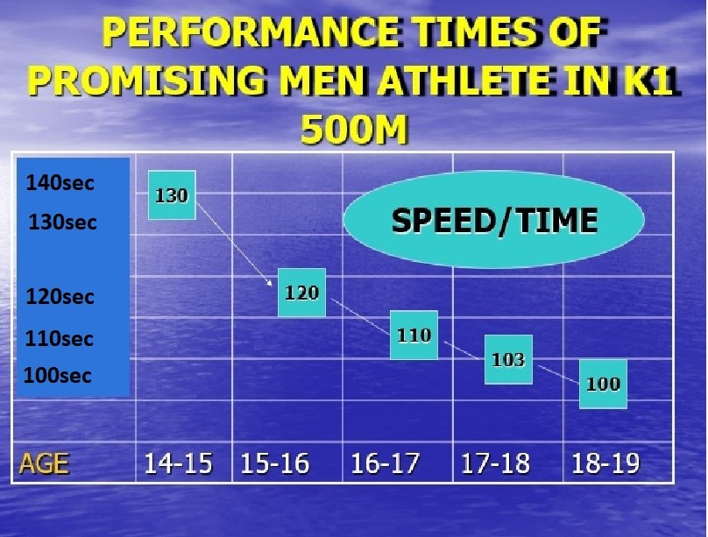

Slide 23
Thank you for listening
david.larsen@kanot.com

